Slide 1
Improving Project Effectiveness
Adria Peterkin
February 14, 2018 ( Happy Valentines Day ! )
Integrating Nuclear and Renewable Energy Sources

Slide 2


Integrating Nuclear and Renewable Energy Sources

Slide 3
Project Health Diagnostic
Attribute | Overall Health | Examples
Value and Metrics | Healthy | Goals are clearly defined, and we understand each individual step that needs to be taken to accomplish overall project goal.
Proof of Concepts | Neutral | From an overall project perspective, there is still much work to be accomplished. Although we have properly defined components of the system, there are still other components that need to be solved.
Velocity | Neutral | We started out on track with defining the system but as we went deeper into solving properties of the components be got stuck and took awhile to figure out their properties.
Managed Dependencies | Neutral | As we continue digging into the project there are more complexities that we begin to discover.

Slide 4

Managed Dependencies

Slide 5
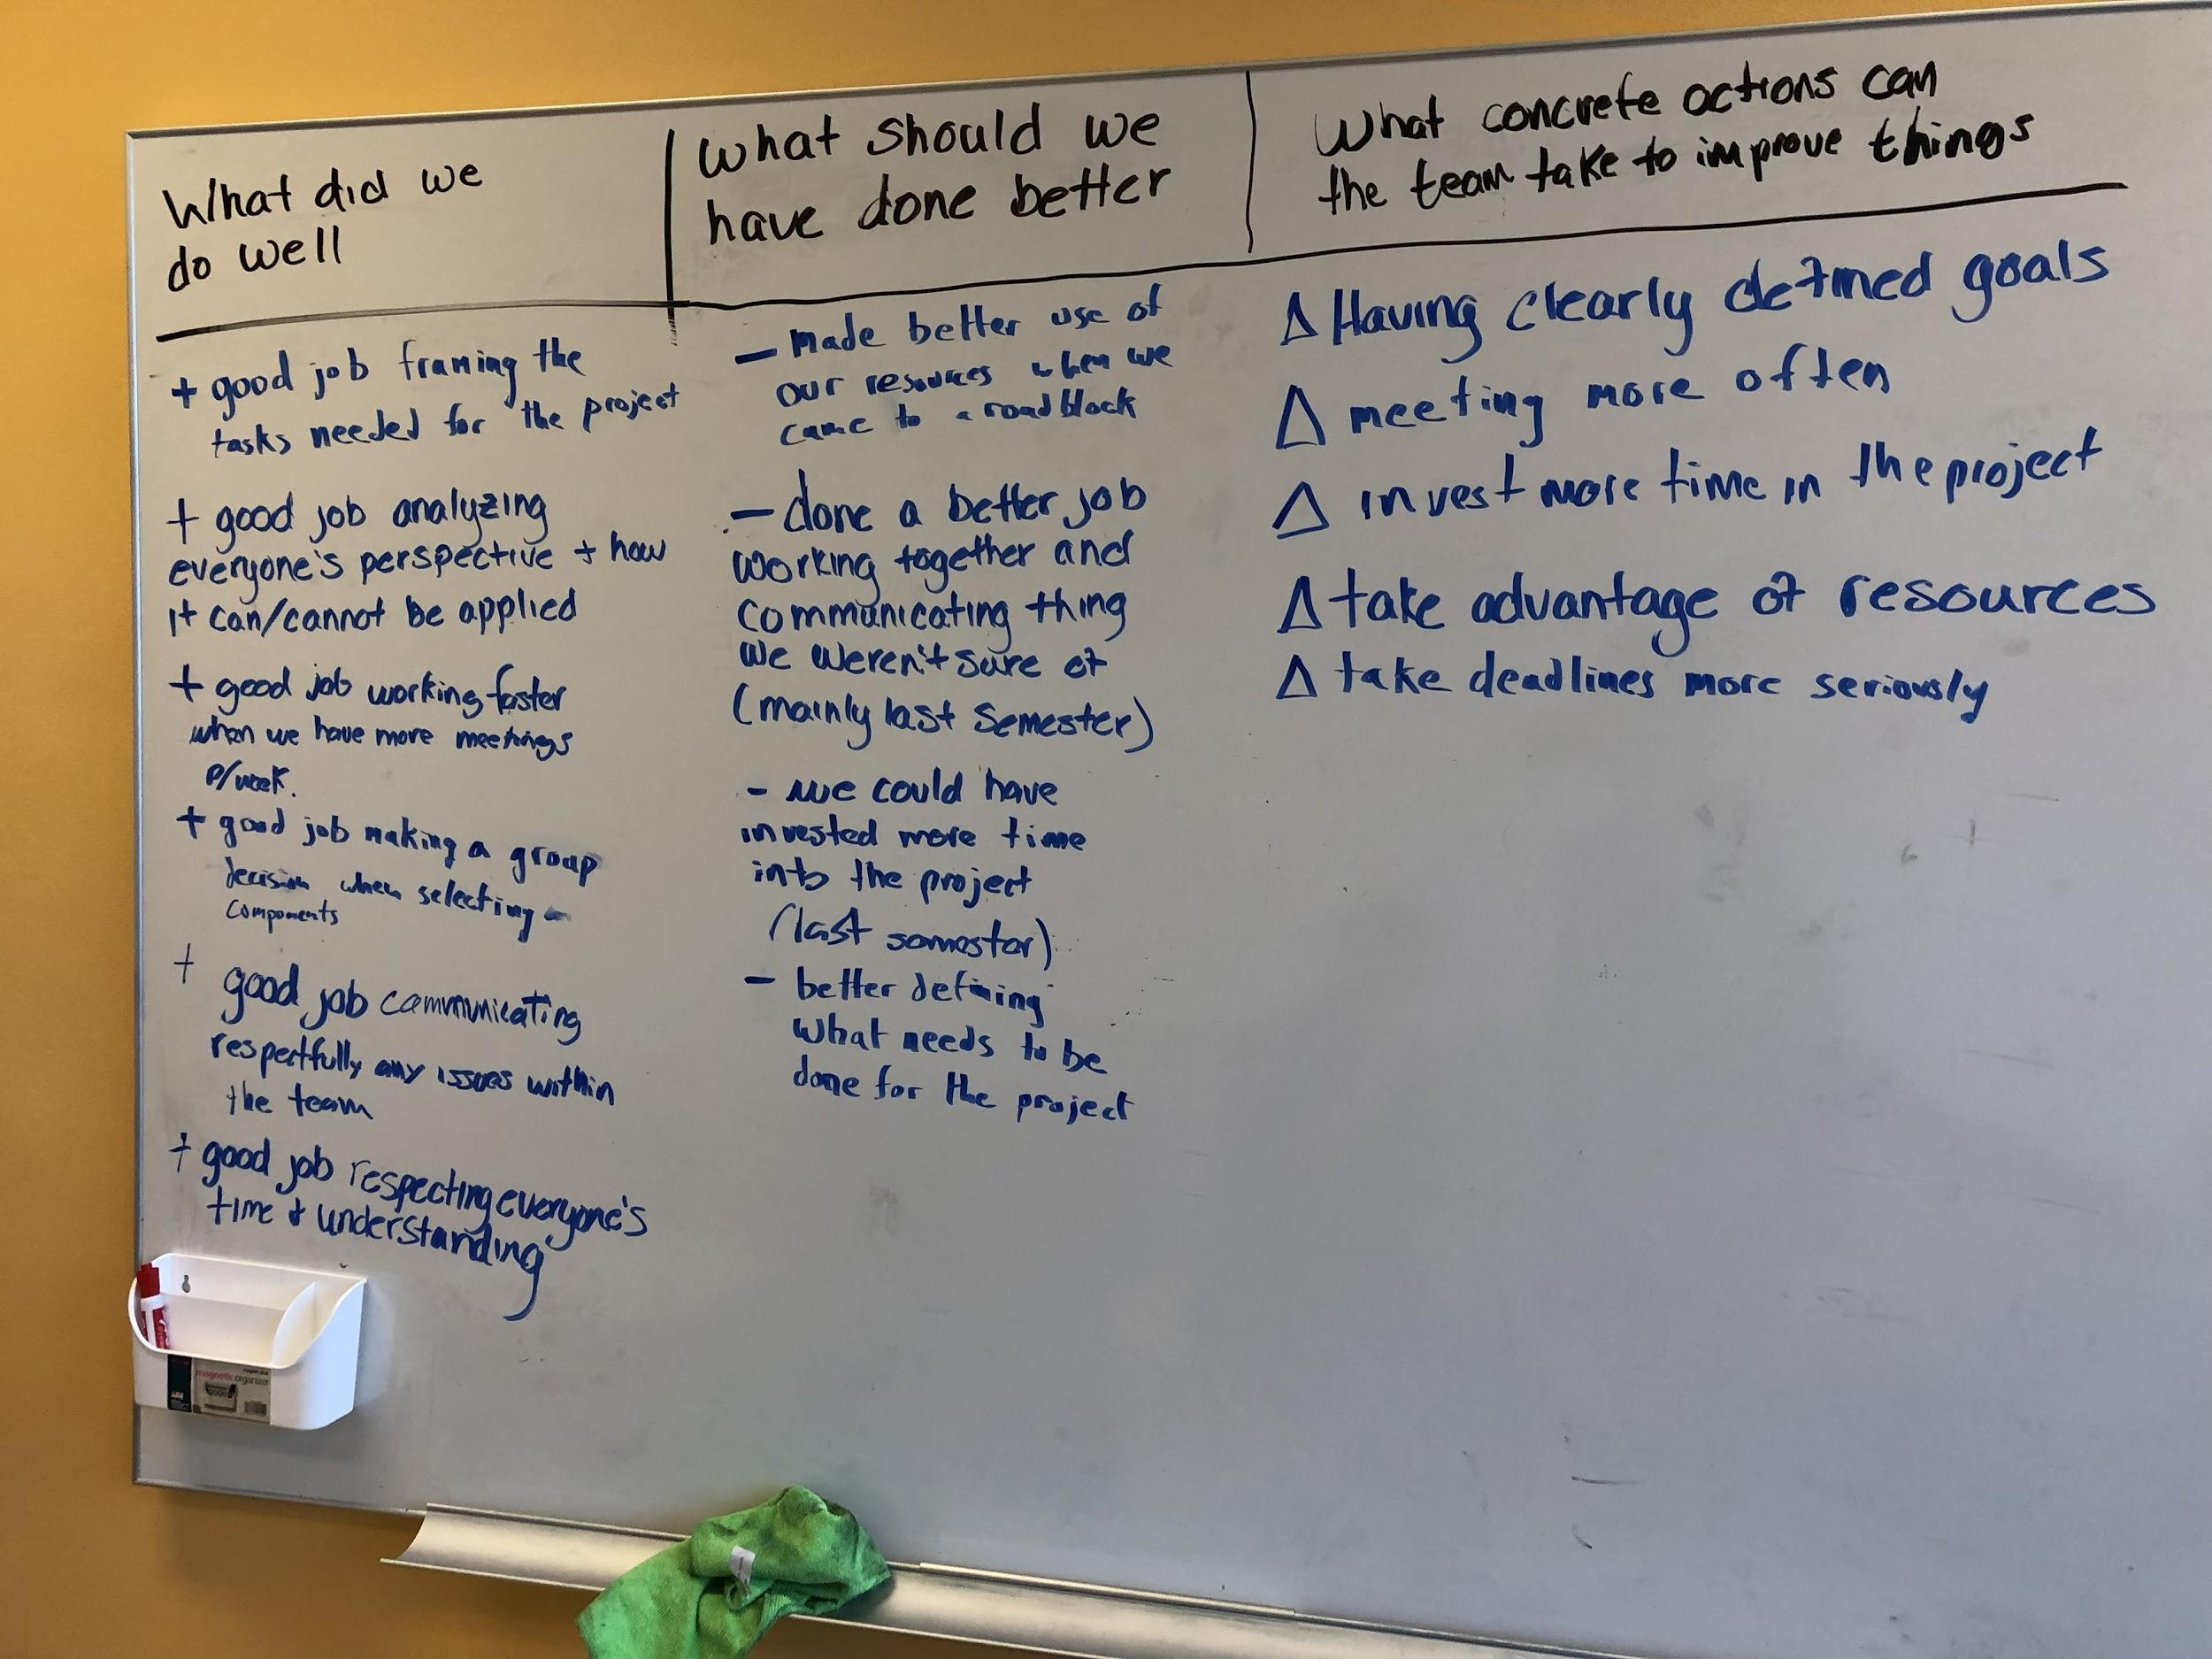
Atlassian- Retrospectives

Slide 6
Questions to think about
How did your Project team manage unforeseen project complexities ?
How did this affect the project team’s velocity ?

Slide 7


